Slide 1
Quantum Mechanics for Electronic Structure II
Bulk and Periodic Solids (Lab)
Yuan Ping
University of Wisconsin-Madison
Part of slides from lecture of Shobhana Narasimhan, JNCASR

Slide 2
Outline
First-principles calculation with periodic boundary condition (crystal)
Bravais lattice
Periodic boundary condition
Bloch theory and reciprocal space
Brillouin zone
Si crystal
SCF calculation
Band structure
Density of states

Slide 3
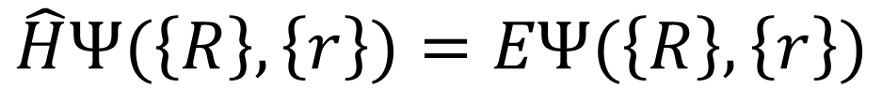
Density Functional Theory
Time-independent Schrödinger equation of multiple nuclei and electrons
Kohn-Sham equations of single electron:
$$\hat{H}Ψ(\left\{R\right\},\left\{r\right\})=EΨ(\left\{R\right\},\left\{r\right\})$$
$$\left(\hat{T}+{\hat{V}}_{ext}+{\hat{V}}_{Hartree}+{\hat{V}}_{xc}\right)ψ_{i}\left(r\right)=ε_{i}ψ_{i}(r)$$

Slide 4
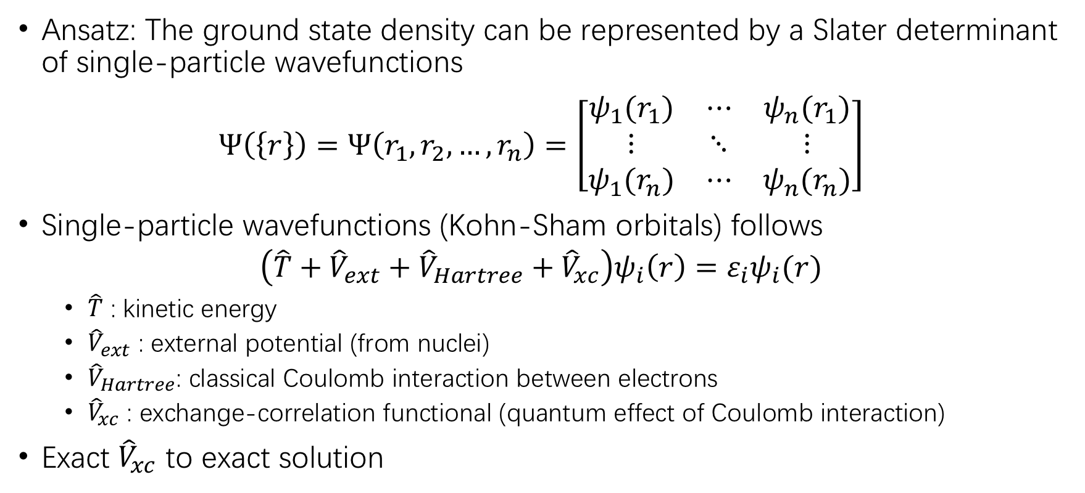
Kohn-Sham equation
Ansatz: The ground state density can be represented by a Slater determinant of single-particle wavefunctions
$$Ψ\left(\left\{r\right\}\right)=Ψ\left(r_{1},r_{2},…,r_{n}\right)=\left[\begin{matrix}ψ_{1}(r_{1}) & ⋯ & ψ_{n}(r_{1}) \\ ⋮ & ⋱ & ⋮ \\ ψ_{1}(r_{n}) & ⋯ & ψ_{n}(r_{n})\end{matrix}\right]$$
Single-particle wavefunctions (Kohn-Sham orbitals) follows
$$\left(\hat{T}+{\hat{V}}_{ext}+{\hat{V}}_{Hartree}+{\hat{V}}_{xc}\right)ψ_{i}\left(r\right)=ε_{i}ψ_{i}(r)$$
$\hat{T}$ : kinetic energy
${\hat{V}}_{ext}$ : external potential (from nuclei)
${\hat{V}}_{Hartree}$: classical Coulomb interaction between electrons
${\hat{V}}_{xc}$ : exchange-correlation functional (quantum effect of Coulomb interaction)
Exact ${\hat{V}}_{xc}$ to exact solution

Slide 5
We can solve a small molecule but…
10²³ atoms in 1cm³ solid material
Impossible to calculate directly!
Crystal : solid material arranged in an ordered structure
Utilize this condition to simplify the problem?
…

Slide 6
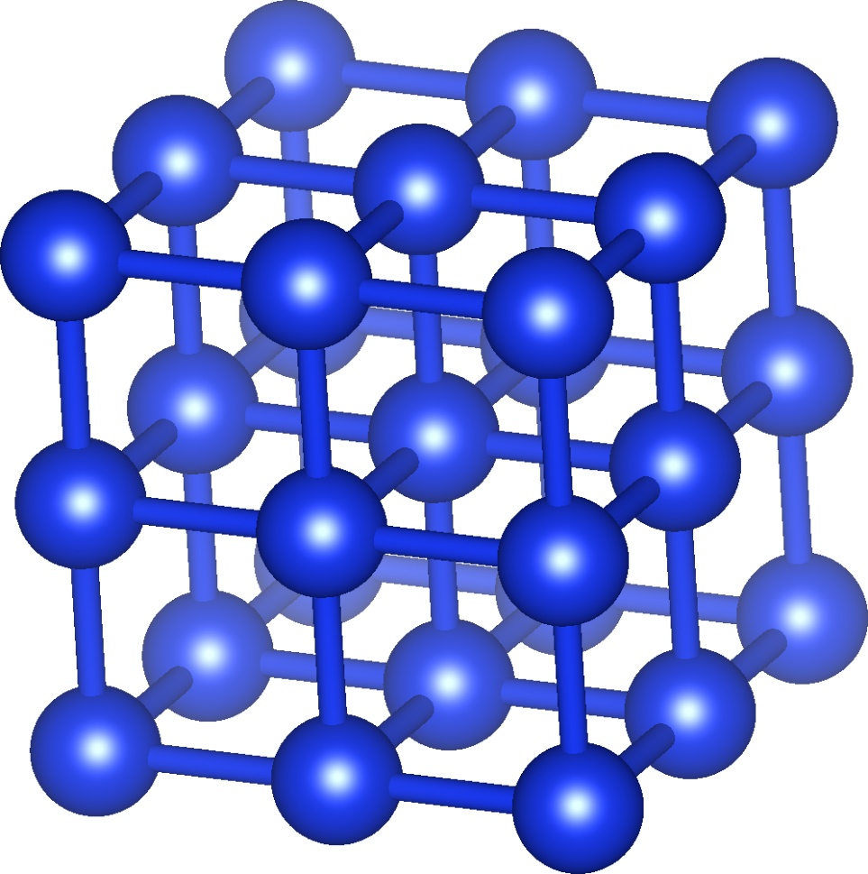
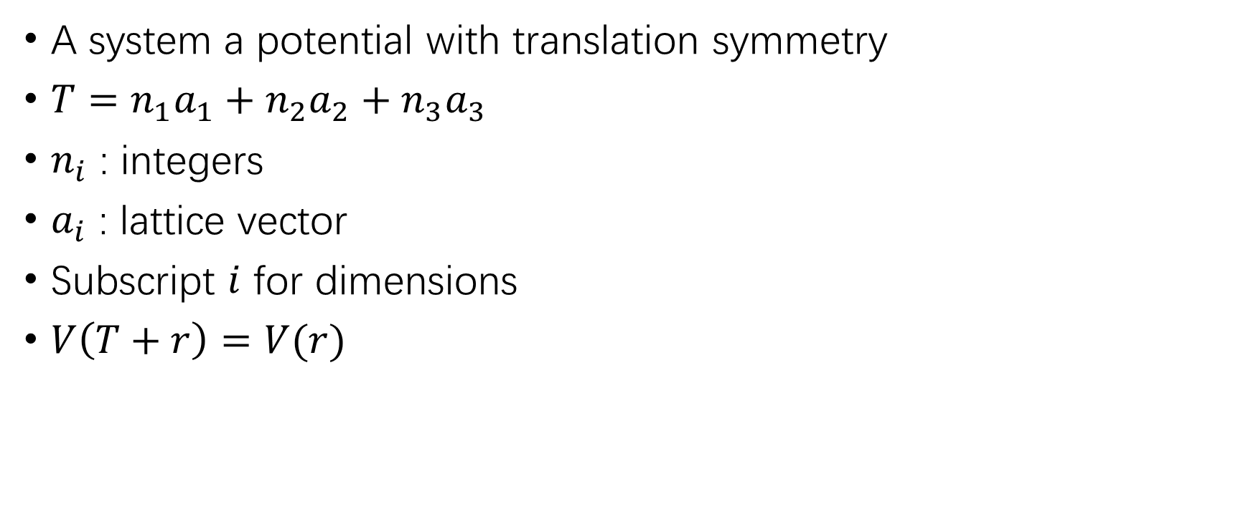
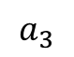
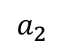
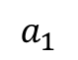
Bravais Lattice
A system a potential with translation symmetry
$T=n_{1}a_{1}+n_{2}a_{2}+n_{3}a_{3}$
$n_{i}$ : integers
$a_{i}$ : lattice vector
Subscript $i$ for dimensions
$V\left(T+r\right)=V(r)$
$$a_{2}$$
$$a_{3}$$
$$a_{1}$$

Slide 7
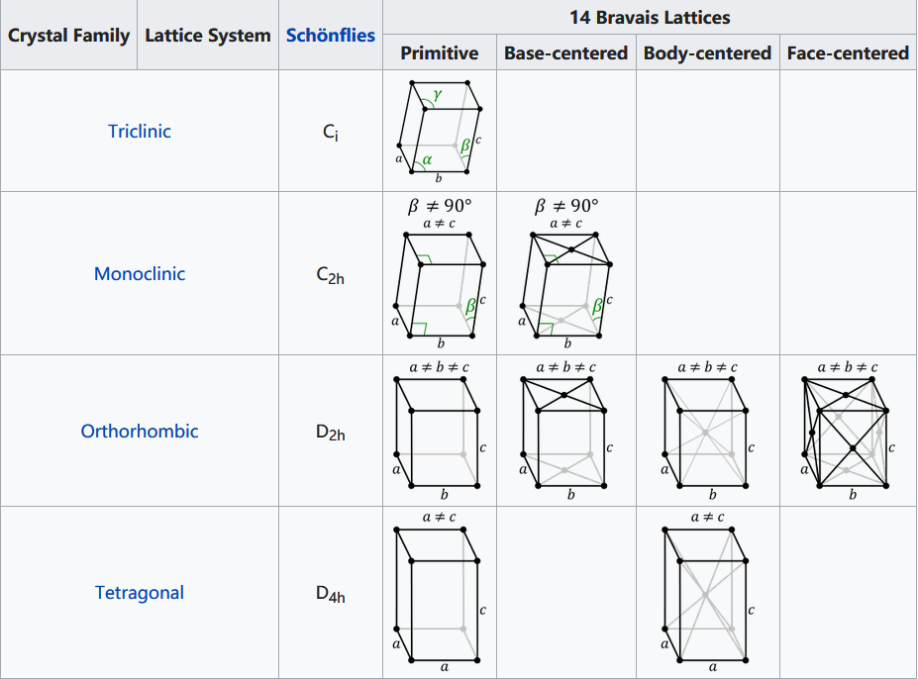
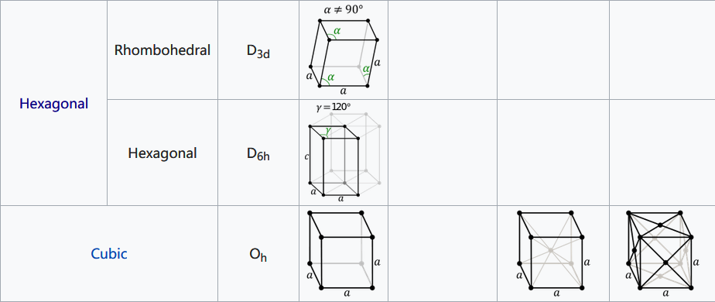
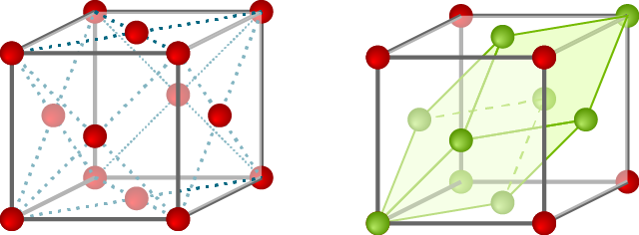
Bravais Lattice
Classified in 7 lattice system and 14 lattices according to symmetry
Centered cell can be further reduced to smaller primitive cell
Convention cell (FCC) Primitive cell (FCC)
https://www.physics-in-a-nutshell.com/article/11/close-packed-structures-fcc-and-hcp
https://en.wikipedia.org/wiki/Bravais_lattice

Slide 8
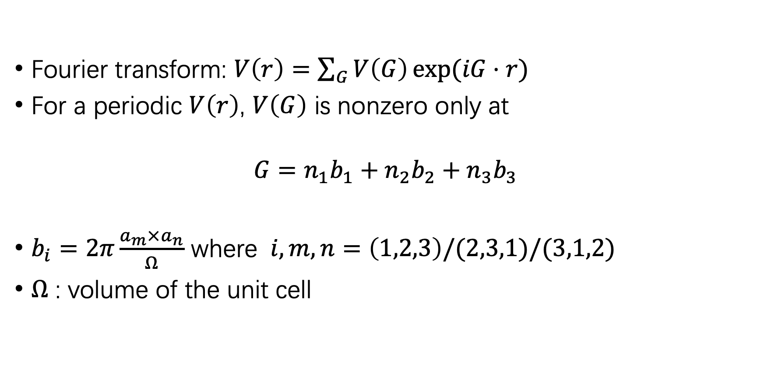
Reciprocal lattice
Fourier transform: $V\left(r\right)=\sum_{G}{V\left(G\right)\exp{(iG⋅r)}}$
For a periodic $V\left(r\right)$, $V\left(G\right)$ is nonzero only at
$$G=n_{1}b_{1}+n_{2}b_{2}+n_{3}b_{3}$$
$b_{i}=2π\frac{a_{m}×a_{n}}{Ω}$ where $i,m,n=\left(1,2,3\right)/(2,3,1)/(3,1,2)$
$Ω$ : volume of the unit cell

Slide 9
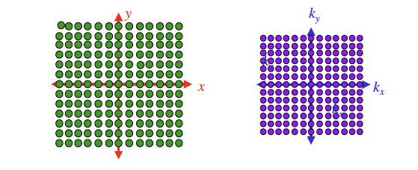
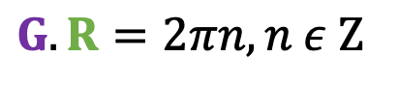
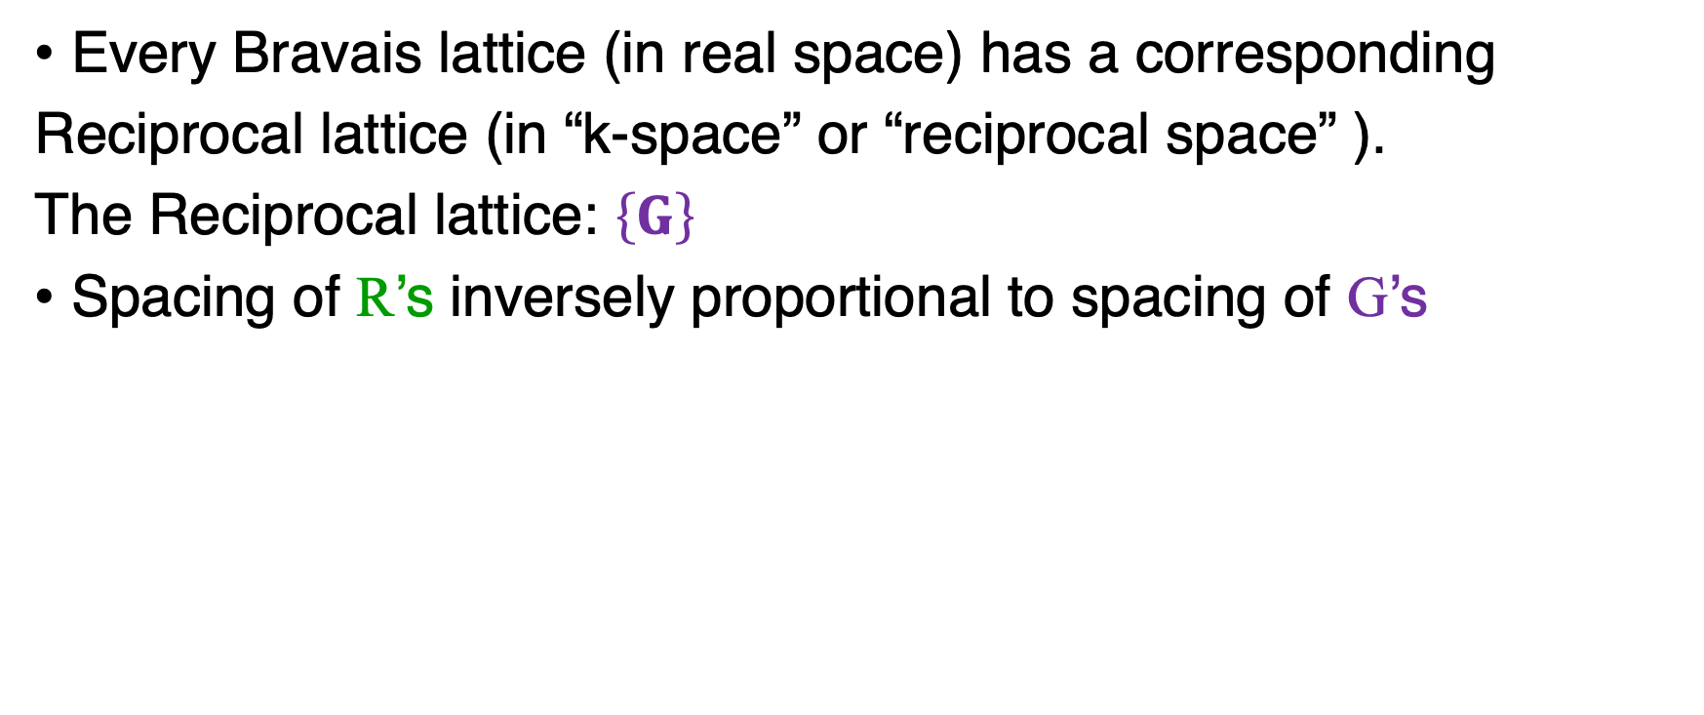
Reciprocal Lattice
Every Bravais lattice (in real space) has a corresponding
Reciprocal lattice (in “k-space” or “reciprocal space” ).
The Reciprocal lattice: $\left\{G\right\}$
Spacing of R’s inversely proportional to spacing of G’s
$$G.R=2πn, n ε Z$$

Slide 10
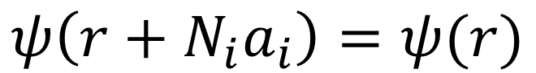
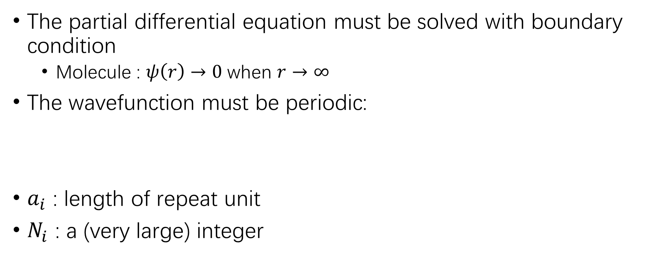
Born-von Karman boundary condition
The partial differential equation must be solved with boundary condition
Molecule : $ψ\left(r\right)→0$ when $r→∞$
The wavefunction must be periodic:
$a_{i}$ : length of repeat unit
$N_{i}$ : a (very large) integer
$$ψ\left(r+N_{i}a_{i}\right)=ψ(r)$$

Slide 11
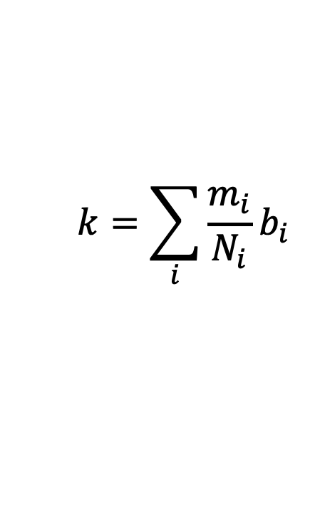
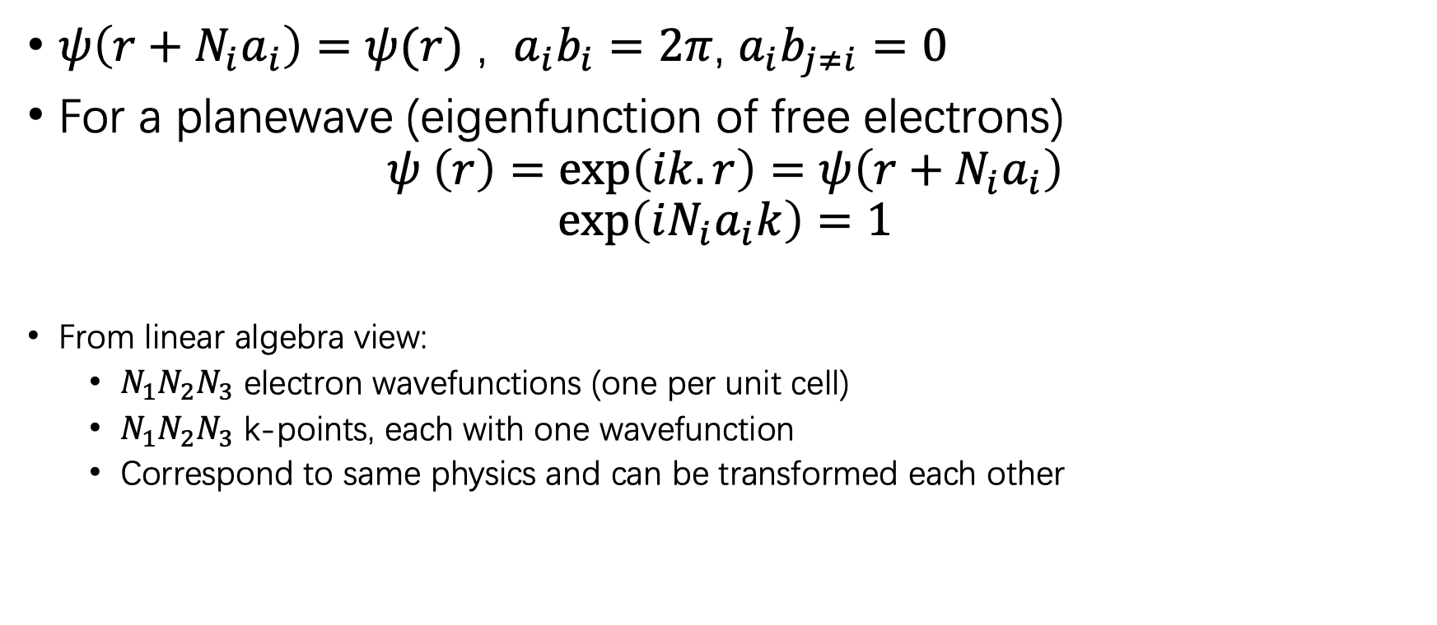
Reciprocal vector
$ψ\left(r+N_{i}a_{i}\right)=ψ(r)$ , $a_{i}b_{i}=2π$, $a_{i}b_{j≠i}=0$
For a planewave (eigenfunction of free electrons) $ψ \left(r\right)=\exp\left(ik.r\right)=ψ\left(r+N_{i}a_{i}\right)$
$$\exp\left(iN_{i}a_{i}k\right)=1$$
From linear algebra view:
$N_{1}N_{2}N_{3}$ electron wavefunctions (one per unit cell)
$N_{1}N_{2}N_{3}$ k-points, each with one wavefunction
Correspond to same physics and can be transformed each other
$$k=\sum_{i}{\frac{m_{i}}{N_{i}}b_{i} }$$
Number of allowed k’s in the 1st (or any other) BZ = Number of unit cells in the crystal, i.e., determined by size of supercell chosen

Slide 12
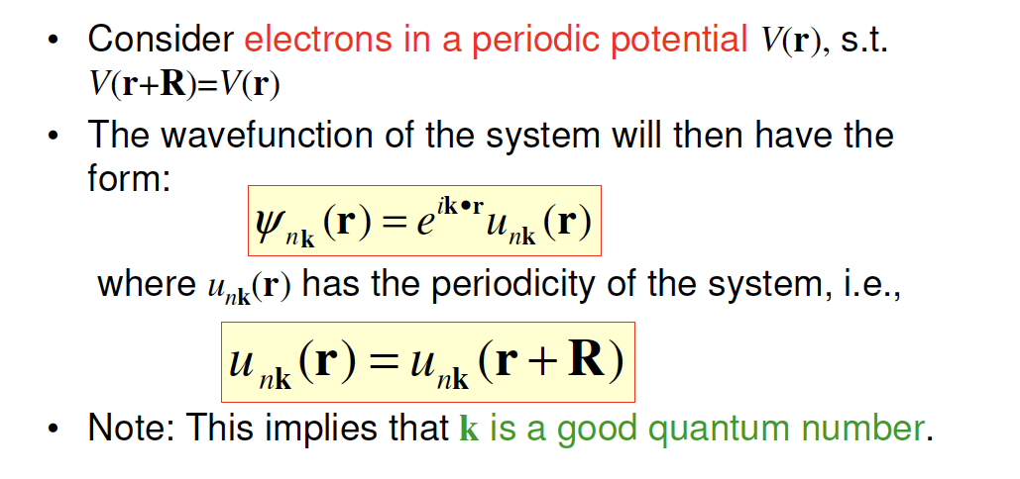
Bloch Theorem
Note that n represents the band index!

Slide 13
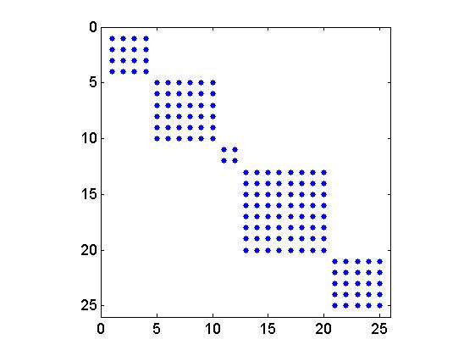
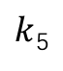
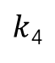
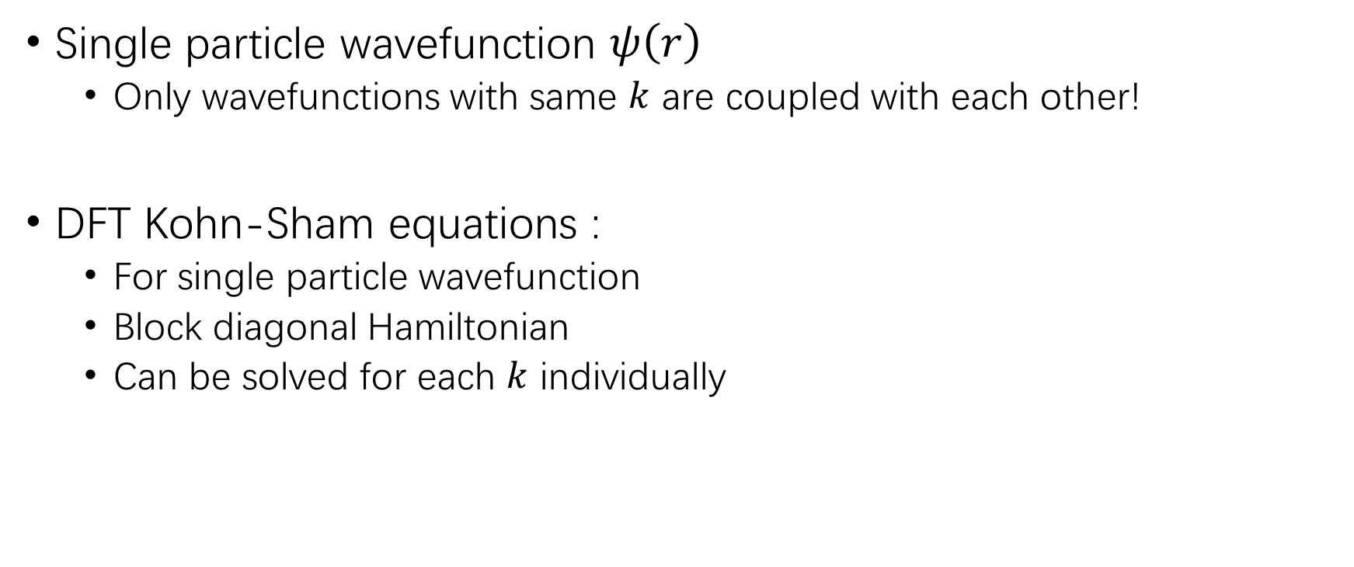
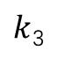
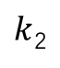
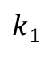
Bloch theorem and DFT
Single particle wavefunction $ψ\left(r\right)$
Only wavefunctions with same $k$ are coupled with each other!
DFT Kohn-Sham equations :
For single particle wavefunction
Block diagonal Hamiltonian
Can be solved for each $k$ individually
$k$₁
$k$₂
$k$₃
$k$₄
$k$₅
https://www.mathworks.com/matlabcentral/fileexchange/46972-sparse-block-diagonal-concatenation

Slide 14


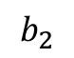
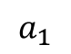
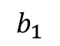
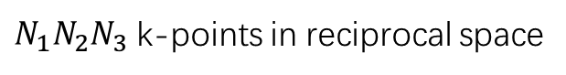
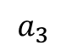
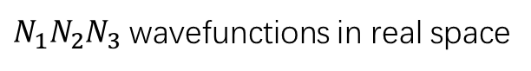
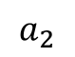
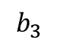
K-point sampling
Continuous in reciprocal space
$$b_{2}$$
$$a_{2}$$
$$a_{3}$$
$$b_{3}$$
$$a_{1}$$
$$b_{1}$$
A few k-points in reciprocal space
$N_{1}N_{2}N_{3}$ wavefunctions in real space
$N_{1}N_{2}N_{3}$ k-points in reciprocal space
Only a few k-points (10¹~10³) are necessary to get most properties of a bulk!

Slide 15
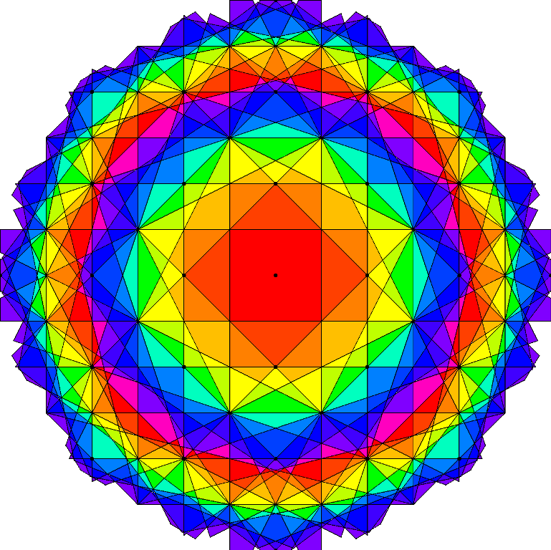
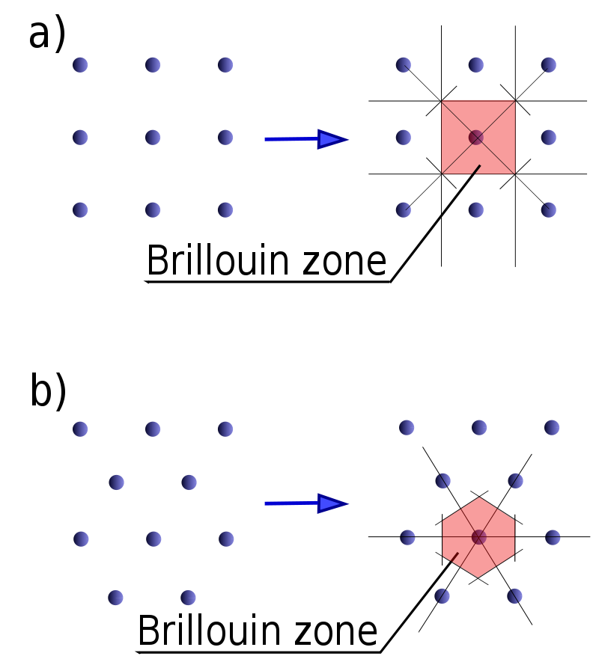
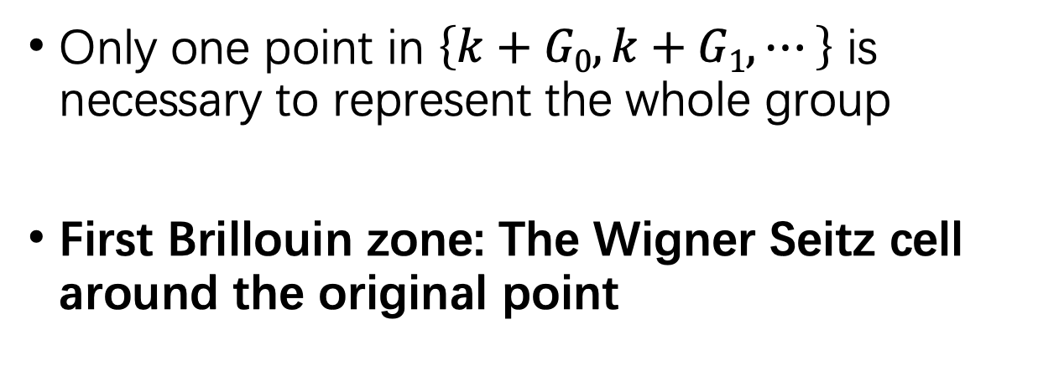
Brillouin zone in reciprocal space
Only one point in $\left\{k+G0,k+G1,⋯\right\}$ is necessary to represent the whole group
First Brillouin zone: The Wigner Seitz cell around the original point
http://skepticsplay.blogspot.com/2011/10/lot-of-brillouin-zones.html
https://en.wikipedia.org/wiki/Brillouin_zone

Slide 16
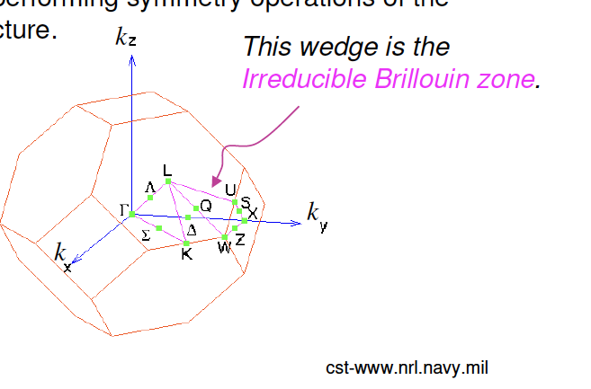
Irreducible Brillouin Zone
Smallest wedge of the 1st BZ such that any wave-vector k in the 1st BZ can be obtained from a wave-vector k in the IBZ by performing symmetry operations of the crystal structure.

Slide 17
Self consistent field (SCF)
ρ_{j}
V_{H,} V_{xc}
ψ_{i}, ε_{i}
ρ_{j+1}=ρ_{j}?
Atomic Density
No
Finish!
Yes
External potential

Slide 18
Self consistent field (SCF) with k-points
ρ_{j}
Atomic Density
No
Finish!
Yes
ρ_{j+1}=ρ_{j}?
V_{H,} V_{xc}
ψ_{i}, ε_{i} (k₁)
Sum
ψ_{i}, ε_{i} (k₂)
External potential
ψ_{i}, ε_{i} (k₂)

Slide 19
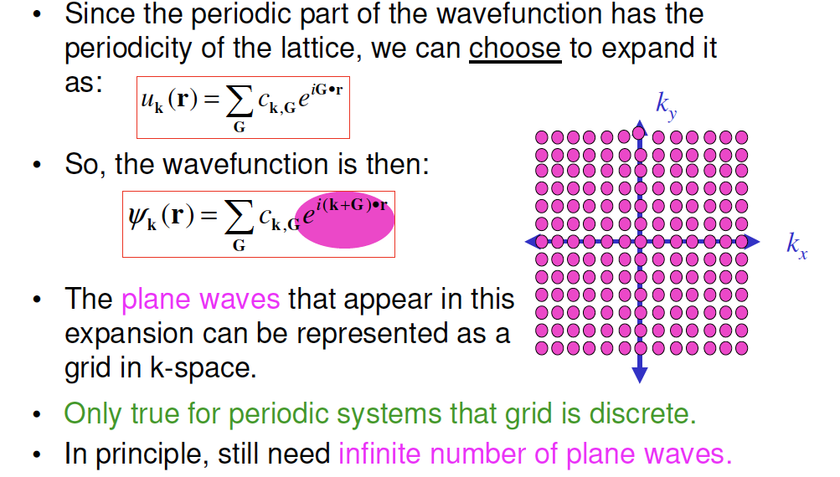
Plane Wave Expansion of Wavefunction

Slide 20
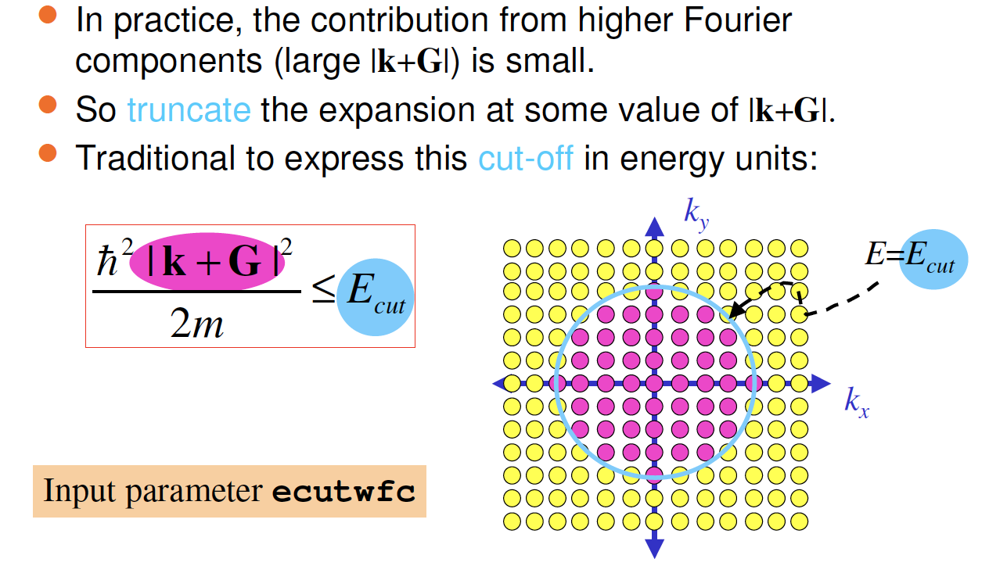
Truncating the Plane Wave Expansion

Slide 21
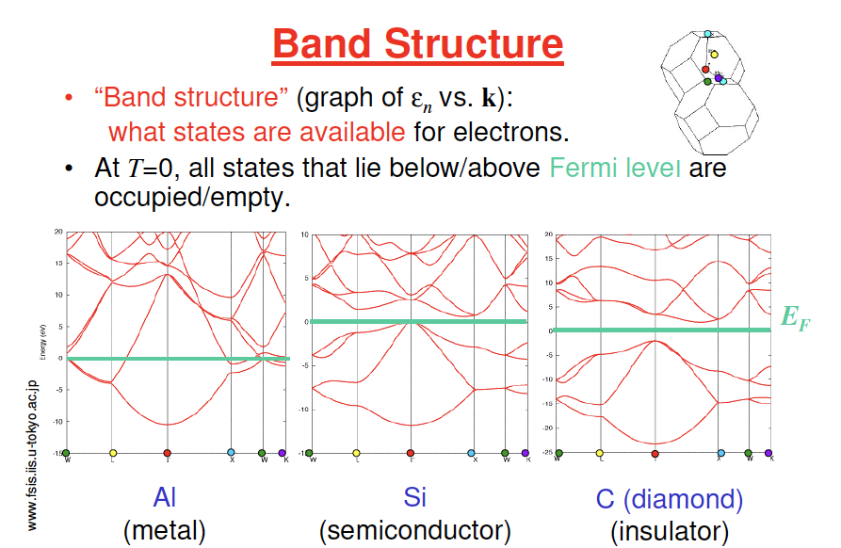

Slide 22
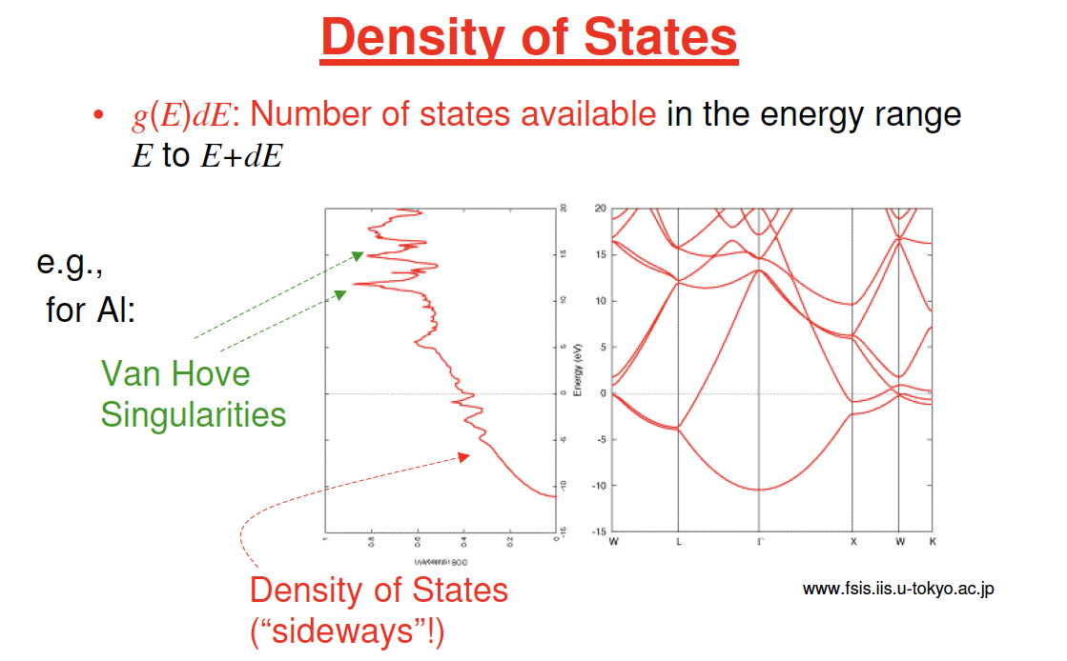
dg(E)/dE diverges

Slide 23
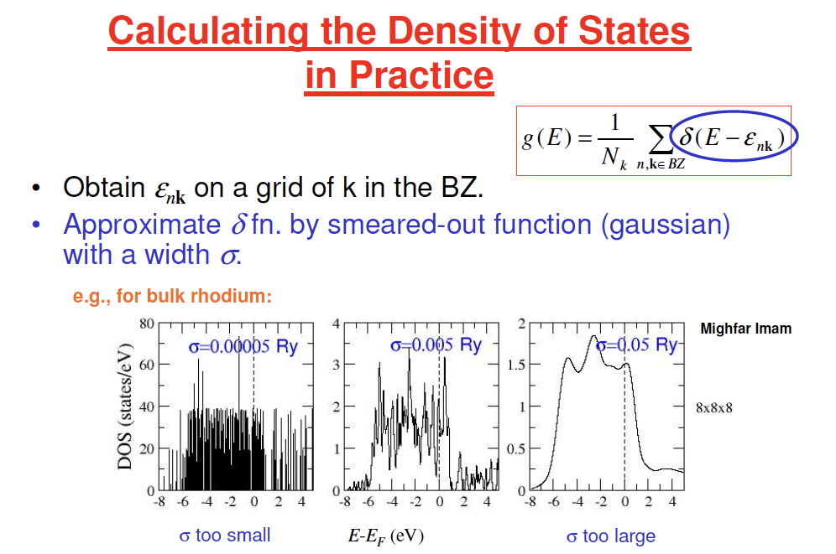

Slide 24
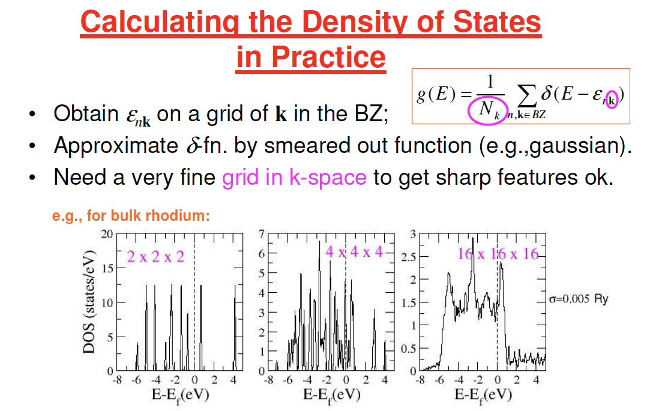

Slide 25
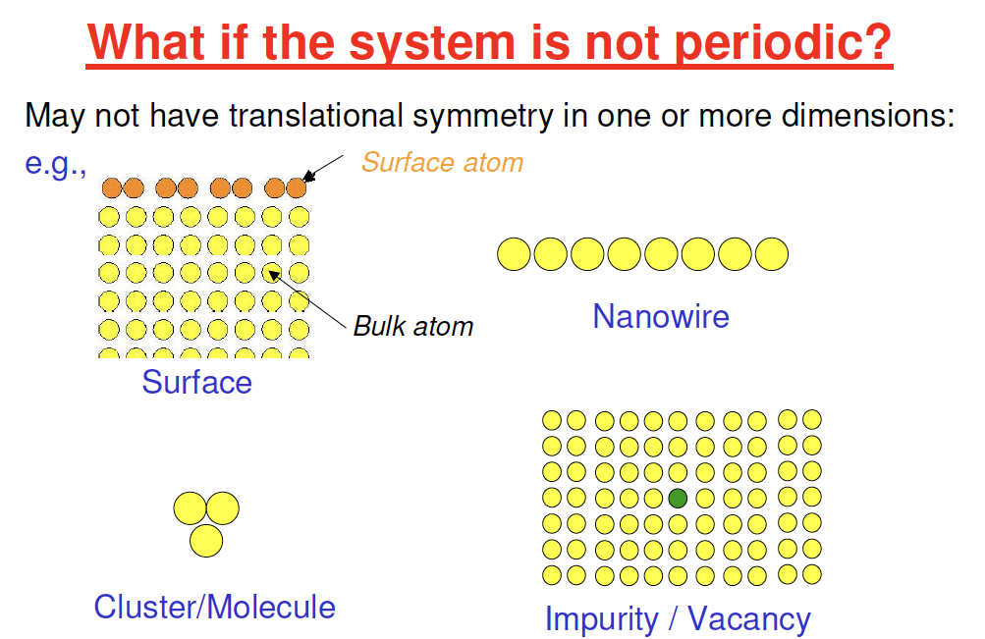

Slide 26
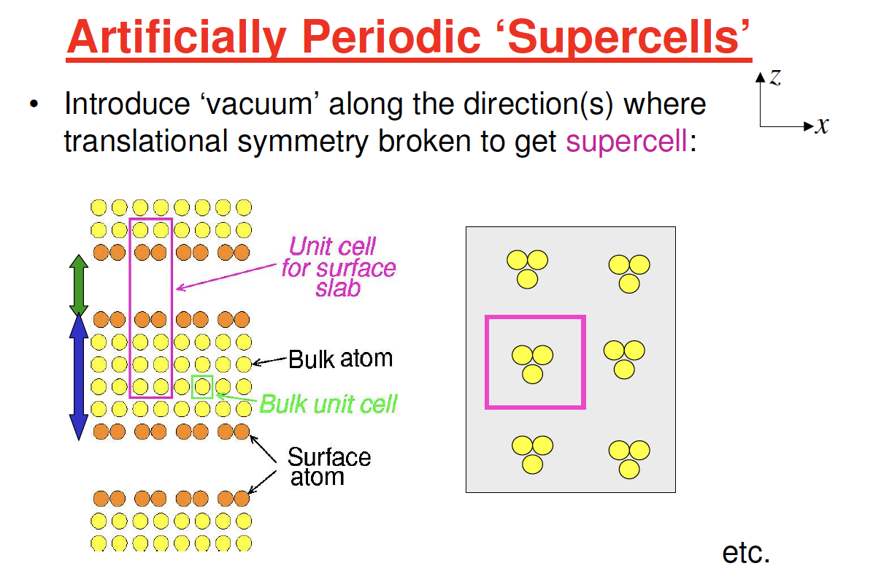

Slide 27
Step 1: K-point sampling and convergence

Slide 28
Born-von Karman boundary condition
The partial differential equation must be solved with boundary condition
Molecule : $ψ\left(r\right)→0$ when $r→∞$
The wavefunction must be periodic:
$a_{i}$ : length of repeat unit
$N_{i}$ : a (very large) integer
$$ψ\left(r+N_{i}a_{i}\right)=ψ(r)$$

Slide 29
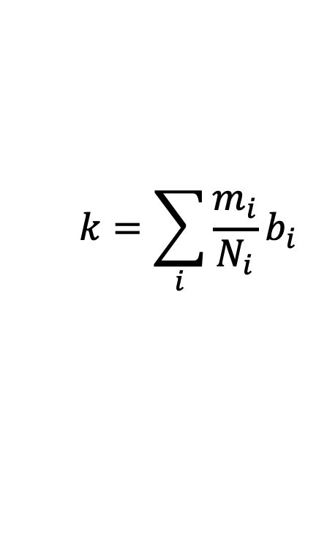
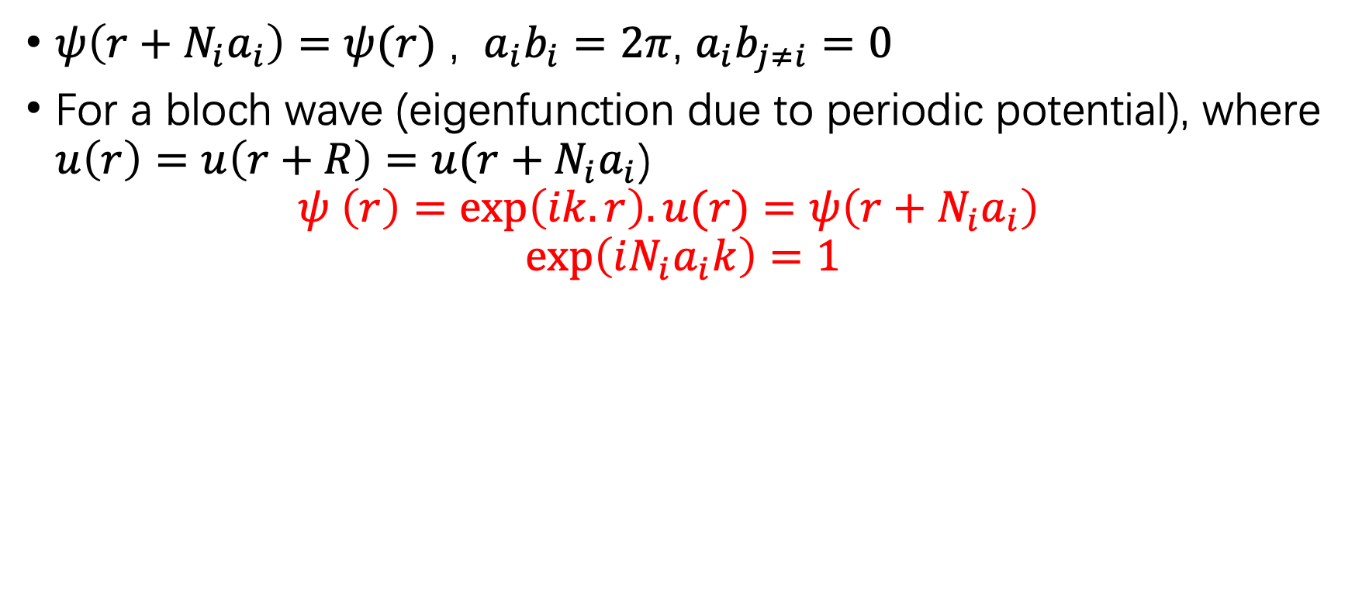
Reciprocal vector
$ψ\left(r+N_{i}a_{i}\right)=ψ(r)$ , $a_{i}b_{i}=2π$, $a_{i}b_{j≠i}=0$
For a bloch wave (eigenfunction due to periodic potential), where $u\left(r\right)=u\left(r+R\right)=u(r+N_{i}a_{i}$) $ψ \left(r\right)=\exp\left(ik.r\right).u(r)=ψ\left(r+N_{i}a_{i}\right)$
$$\exp\left(iN_{i}a_{i}k\right)=1$$
$$k=\sum_{i}{\frac{m_{i}}{N_{i}}b_{i} }$$
Number of allowed k’s in the 1st (or any other) BZ = Number of unit cells in the crystal in real space

Slide 30
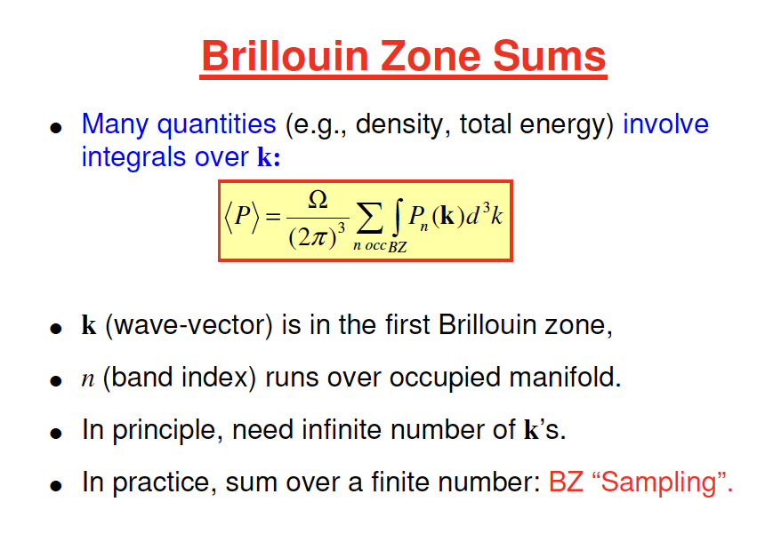

Slide 31
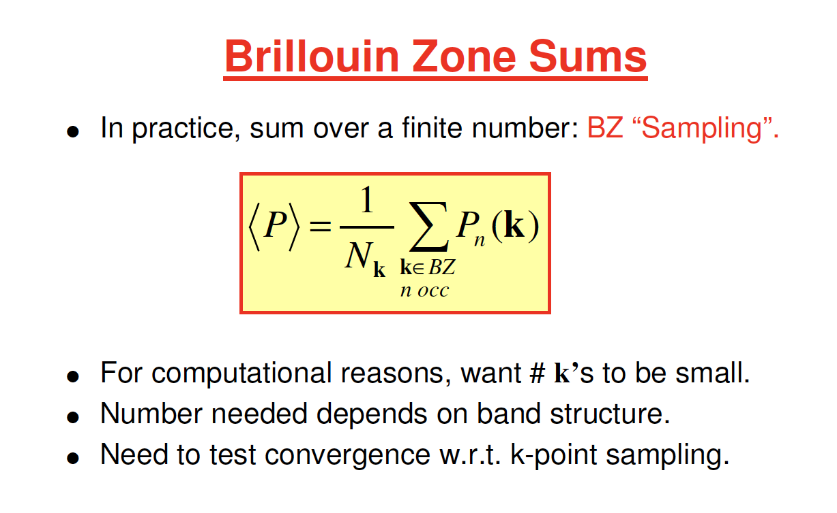

Slide 32


Slide 33


Slide 34


Slide 35


Slide 36


Slide 37


Slide 38


Other practical aspects - poseudopotentials

Slide 39


Slide 40

Ecutrho = 4 x ecutwfc
for norm-conserving

Slide 41


Slide 42


Slide 43

si_pbe_v1.uspp.F.UPF
PBE - Vxc
Uspp - poseudopotential
C_ONCV_PBE-1.0.up
PBE – Vxc
Norm-conserving (ONCV) pp

Slide 44



Slide 45


Slide 46



Slide 47



Slide 48


Slide 49

Example: Si bulk
FCC lattice
2 atoms in primitive cell
Each Si bonded with 4 Si
Band structures: eigenvalues at each k-points
Band gap (direct or indirect)
Density of states: number of states at given energy

Slide 50


Experimental Si Band structure
Calculated Si Band structure

Slide 51
Practice in terminal
Top left :Applications – System Tools – Terminal
Type commands and press enter to run commands in terminal
Run following commands one by one to start:
CHTC:
ssh username@spark-login.chtc.wisc.edu
cd /scratch/username
cp -r /home/groups/mse_course_ping/examples/QE/silicon/
cd silicon

Slide 52


FCC band structure
Special k-points
Xcrysden: Menu-Tools-k-path
https://en.wikipedia.org/wiki/Brillouin_zone

Slide 53
Tasks
On CHTC, type: sbatch qe-batch-script.sh
On local machine
Run a scf calculation to get charge density pw.x < scf.in > scf.out
Run a nscf calculation to get eigenvalues on special k-points pw.x < nscf.in > nscf.out
Run bands.x and plotband.x to generate data files to plot bands.x < bands.in > bands.out plotband.x < plotband.in > plotband.out
Run a nscf calculation for better density of states plot pw.x < nscf-dos.in > nscf-dos.out
Run dos.x to generate data files to plot dos.x < dos.in > dos.out
Alternatively, run: chmod +x run.sh after finish: ./run.sh
CHTC: After finish, download the entire folder to local directory. The visualization software does not work on CHTC.
scp -r username@spark-login.chtc.wisc.edu:/scratch/username/silicon .
Plot bandstructure and DOS gnuplot –persist plot.v4.gnu

Slide 54

Run SCF
‘scf’ for self-consistent-field
set files/folder to read and write and what to write
10.26 Bohr (5Å) FCC cell
2 atoms and 1 types of atoms (Si)
basis set size of wavefunction
Species: Pseudo potentials filename
Position of 2 atoms
6x6x6 K-points

Slide 55

Run NSCF for band structure
Non-self consistent field: compute eigenvalues and wavefunctions from fixed charge density (no update)
Including more bands to plot
A list of special k-points
5 points along each line

Slide 56

Run NSCF for density of states
Non-self consistent field: compute eigenvalues and wavefunctions from fixed charge density (no update)
Specific to make DOS looks better
More k-points for better looking DOS and preserve fine DOS structures
(In this example only 6x6x6 for speed)

Slide 57

Band structure and DOS
Experimental band gap: 1.1eV, indirect
DFT band gap problem: always underestimate gap, 40% to no gap

Slide 58
Not in class

Slide 59

Bloch theorem
All wavefunctions in above conditions can be written as $ψ\left(r\right)=exp\left(ik⋅r\right)u\left(r\right)$ where $u\left(r\right)$ is a periodic function with period $a_{i}$
Proof: $ψ\left(r\right)=\sum_{k′}{C_{k′}\exp{(ik′⋅r)}}=\sum_{k,G}{C_{k,G}\exp{(i(k+G)⋅r)}}$
$k$ limited to $−\frac{b_{i}}{2}<k_{i}<\frac{b_{i}}{2}$ (first Brillouin zone; see later discussion)
With periodic potential $V\left(r\right)=\sum_{G}{V\left(G\right)\exp{(iG⋅r)}}$, $C_{k,G}$ is non-zero only for same $k$, solving SE: $ψ\left(r\right)=\exp\left(ik⋅r\right)\sum_{k,G}{C_{k,G}\exp\left(iG⋅r\right)}=exp\left(ik⋅r\right)u\left(r\right)$

